Slide 1
Player’s auction & team making for tournament
Presenting by :
Azizur Rahman Maruf
B.Sc (engineering) in CSE
Level : 3 Semester : I
Student ID : 1902029
Md Iftekhar Hossain Tushar
B.Sc (engineering) in CSE
Level : 3 Semester : I
Student ID : 1902061
Ananya Das Gupta
B.Sc (engineering) in CSE
Level : 3 Semester : I
Student ID : 1902051

Slide 2
contents
Introduction
Objectives
Literature Review
Requirements
Architecture
Implementation
Future Enhancement
Conclusion
References

Slide 3
Introduction
“Player’s auction & team making for tournament” is the software which Nowadays face much difficulties to organize a match and also difficult to make team combination .The modules are built to provide the display function of managing users’ and authorities’ identification, teams and players information and configuration.

Slide 4
Objectives
Tournament Owner will organize tournament and advertise it to interested team.
Tournament Owner will start the registration of limited team as per his requirement.
Tournament Owner manage paperwork for player detail and team detail for record of the Tournament
Tournament Owner display Rules and Regulation of tournament to every team.
Tournament Owner create match scheduling and give it to every team by phone or message.
Tournament Owner will give us the statistics of auction system.
Dealing with paperwork, phone call, emails and letters.

Slide 5
LITERATURE REVIEW
Videos of course provided by Mohammed Abdul Bari Sir helps to learn JAVA, JAVA Swing and AWT.
Packages and Methods of java are studied from Stack Overflow, Geeks for Geeks, Java Tutorial Point, W3school and some other random websites.
Database language are studied for Insertion, Deleting, Updating, Retrieving from different websites.
To learn Java NetBeans form YouTube videos helped. Combining all knowledge made us stable for making the project properly.

Slide 6
requirements
Software Requirements
Operating System Windows 10
Front End Java, Java Swing, Java AWT
Back End MySQL
IDE NetBeans, Workbench
Hardware Requirements
Desktop PC or a Laptop
Operating System – Windows 10
Intel® CoreTM i3-6006U CPU @ 2.00GHz
4.00 GB RAM
64-bit operating system, x64 based processor
1024 x 768 monitor resolution
Keyboard and Mouse

Slide 7
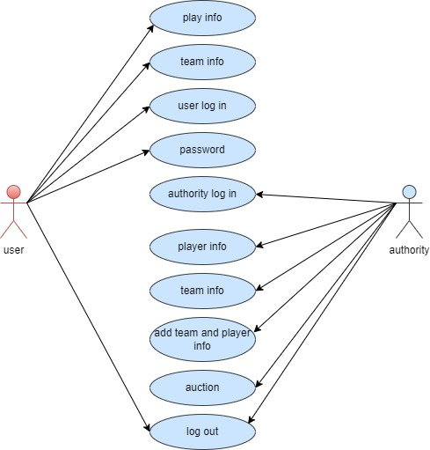
Architecture
Use-case diagram

Slide 8
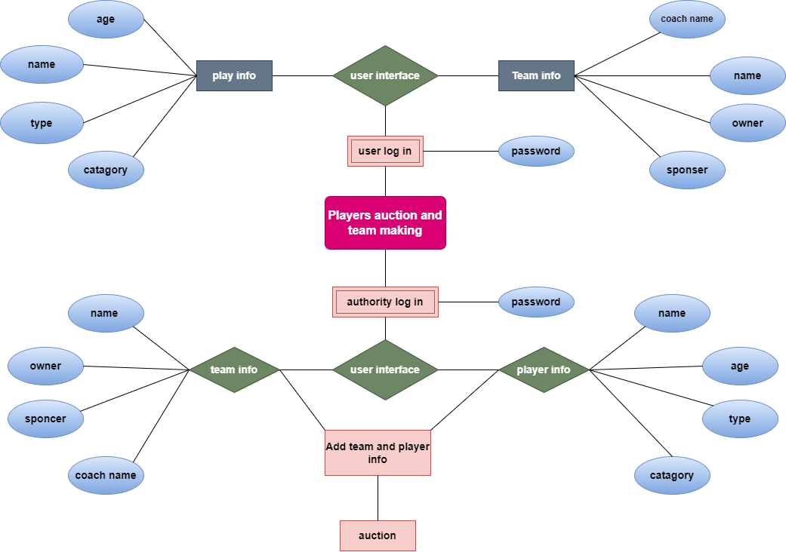
Architecture
E-R diagram

Slide 9
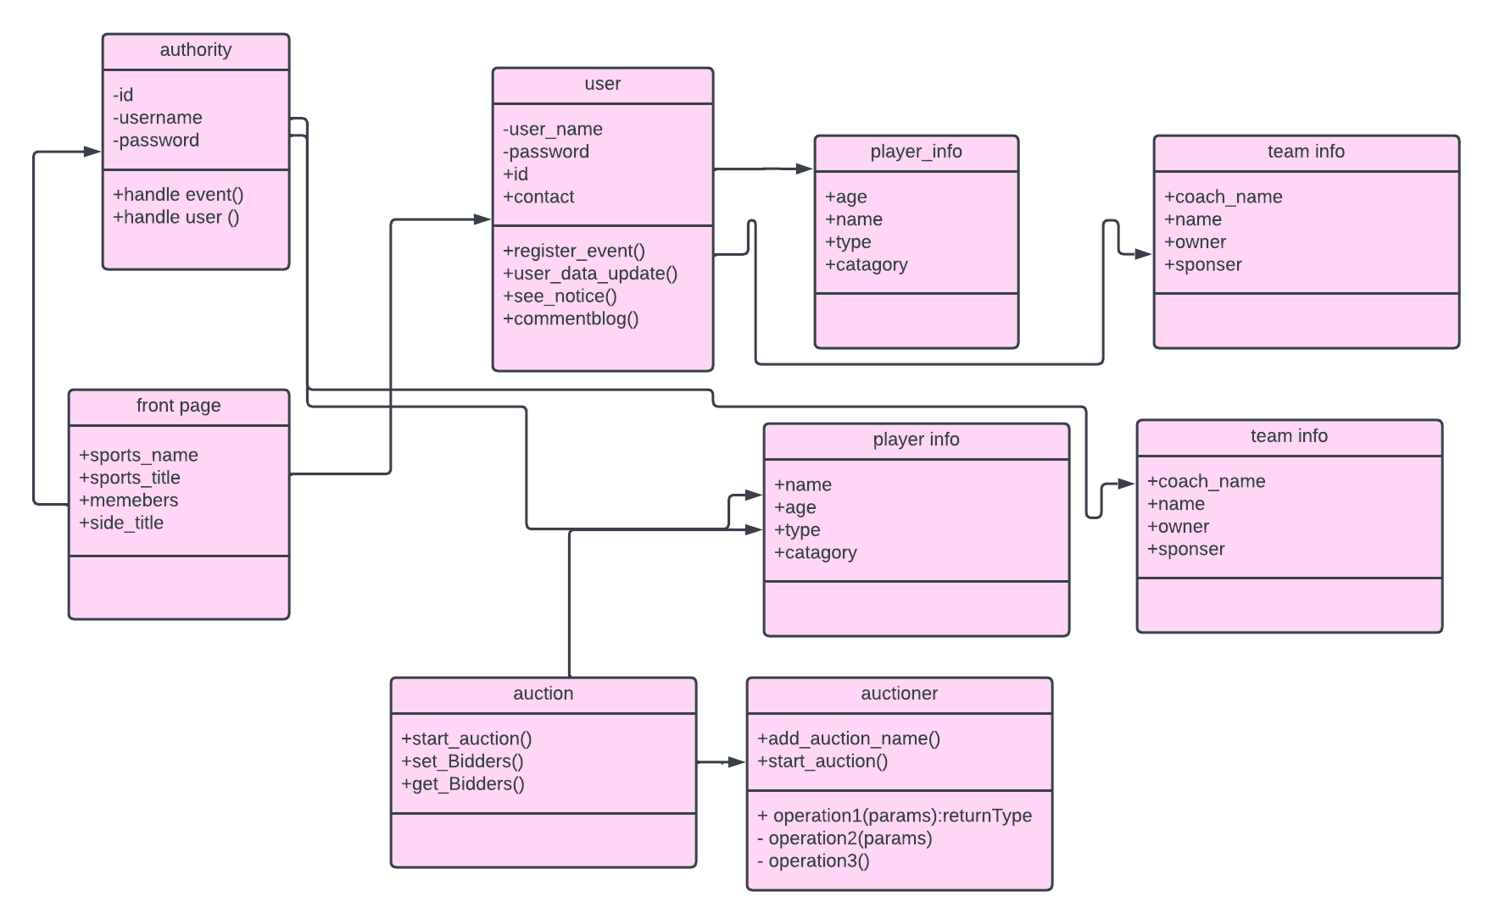
Architecture
Class diagram

Slide 10
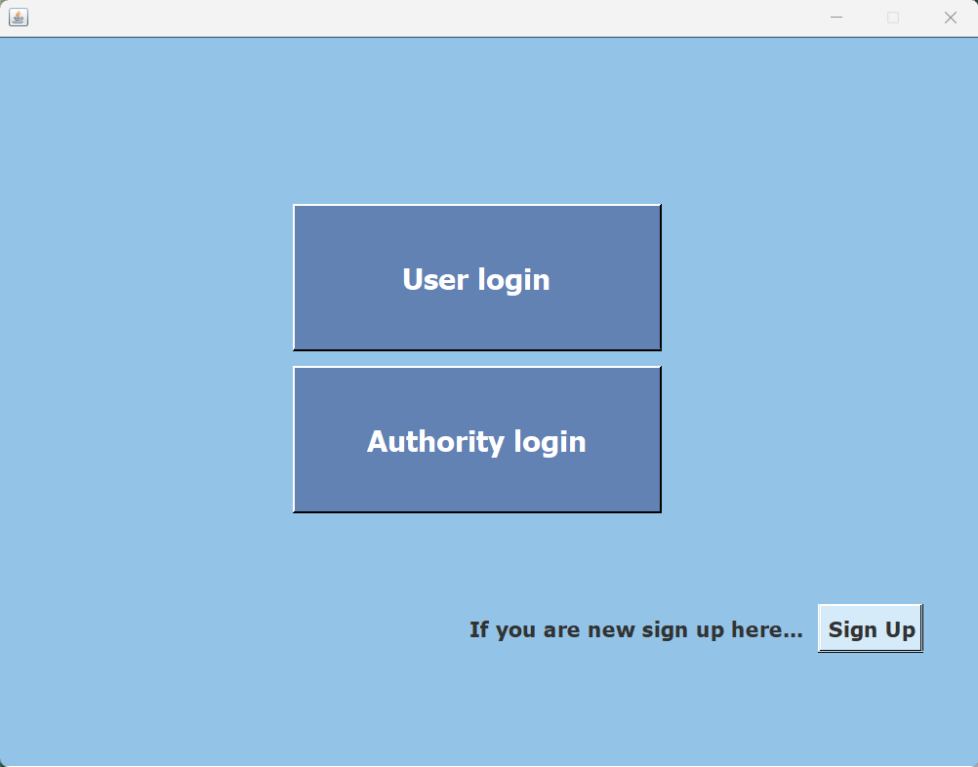
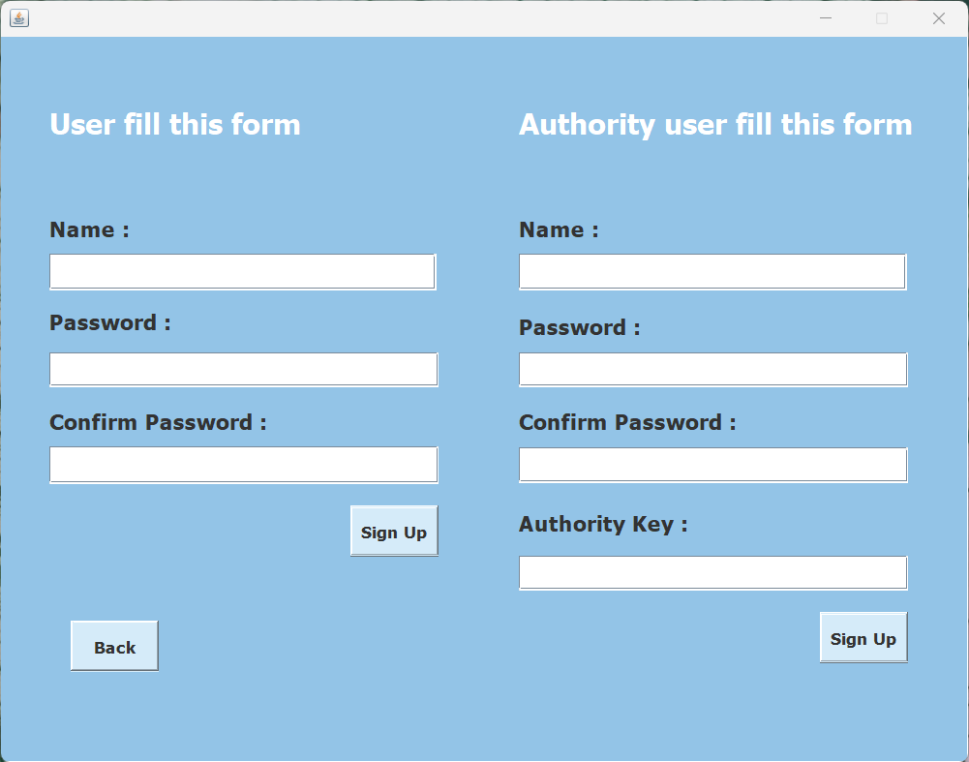
Implementation
Opening page of “Player’s auction & team making for tournament”. There are 3 type of working principle mentioned as Sign up, Users login, Authority login.
Sign up system for authority & user interface are presented in right.

Slide 11
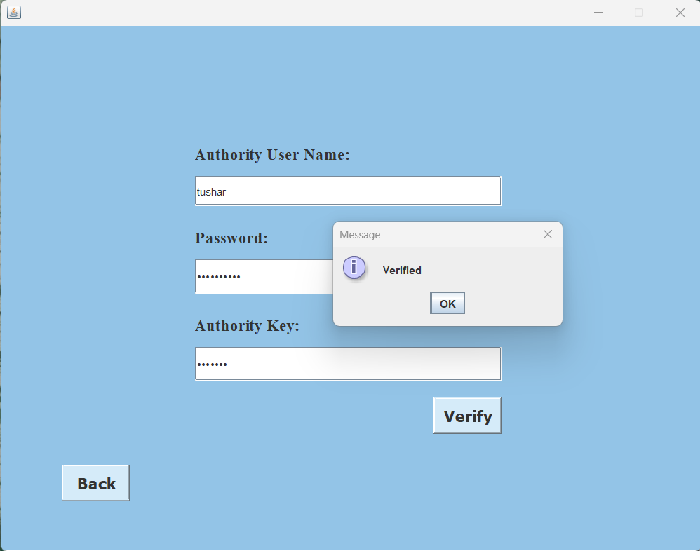
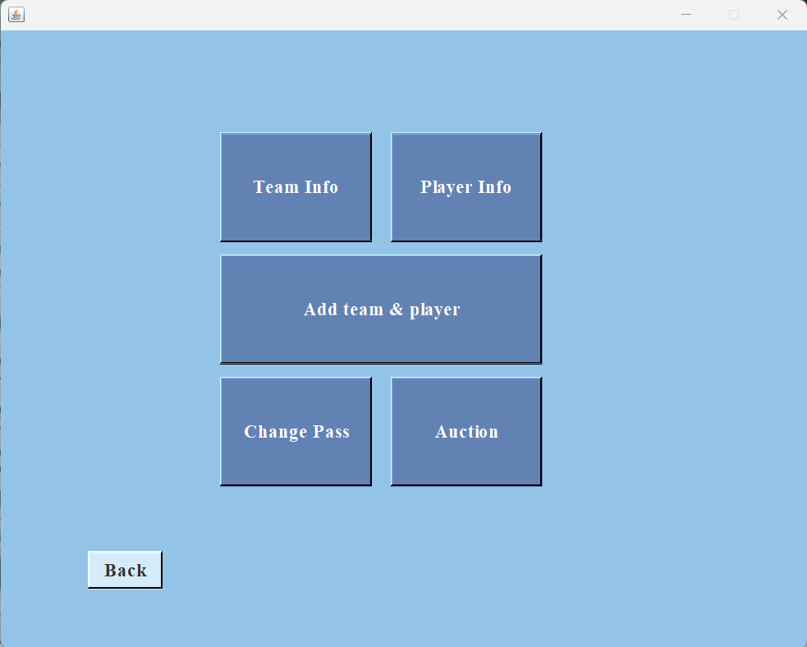
Implementation
Login system for authority checks authentic access is presented in left.
Authority interface is presented in right which has five options mentioned as team info, players info, add team & player, password change for authority and the main theme of this project named “Auction”.

Slide 12
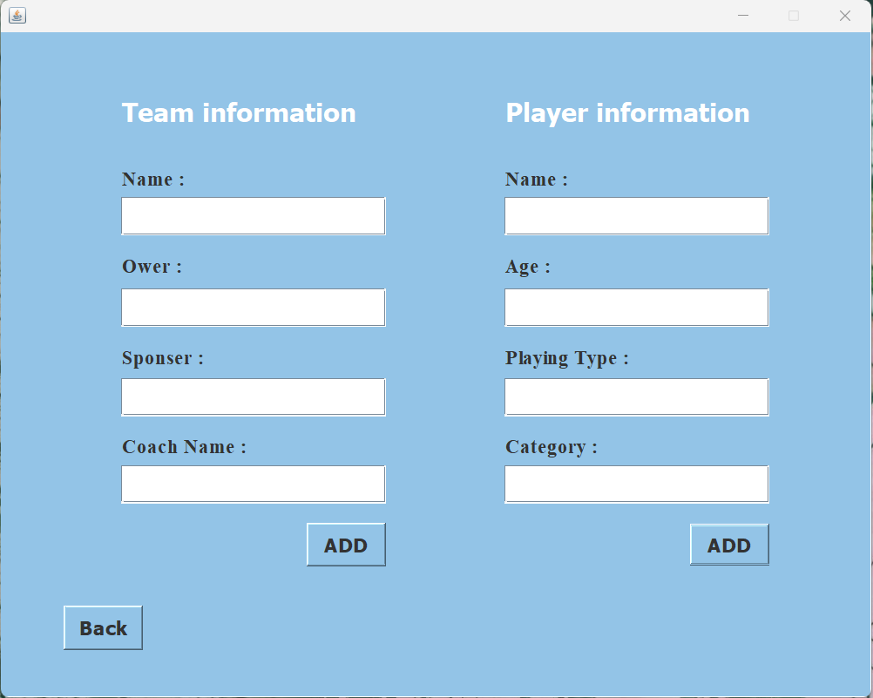
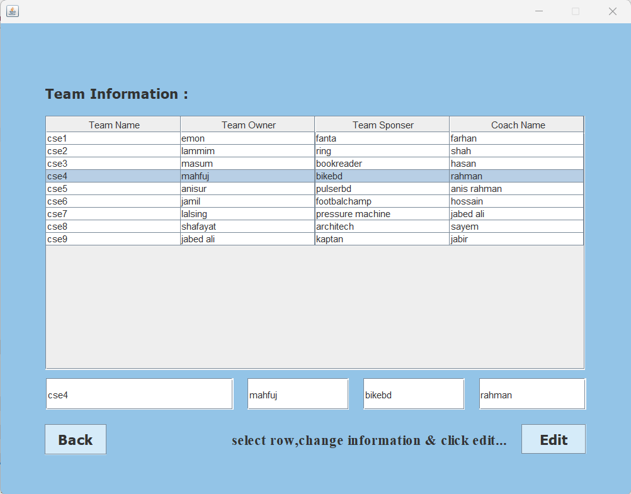
Implementation
Authority can add team & player information by the interface presented in left.
Added teams’ information with editing opportunities presented in right.

Slide 13
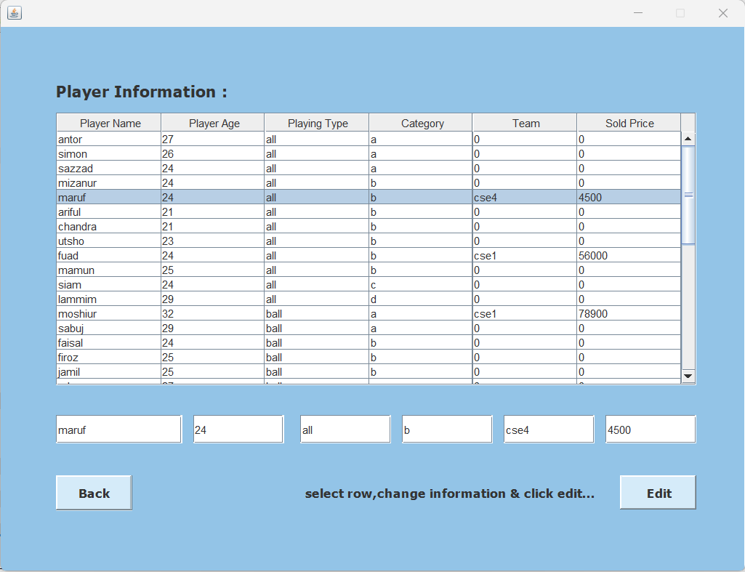
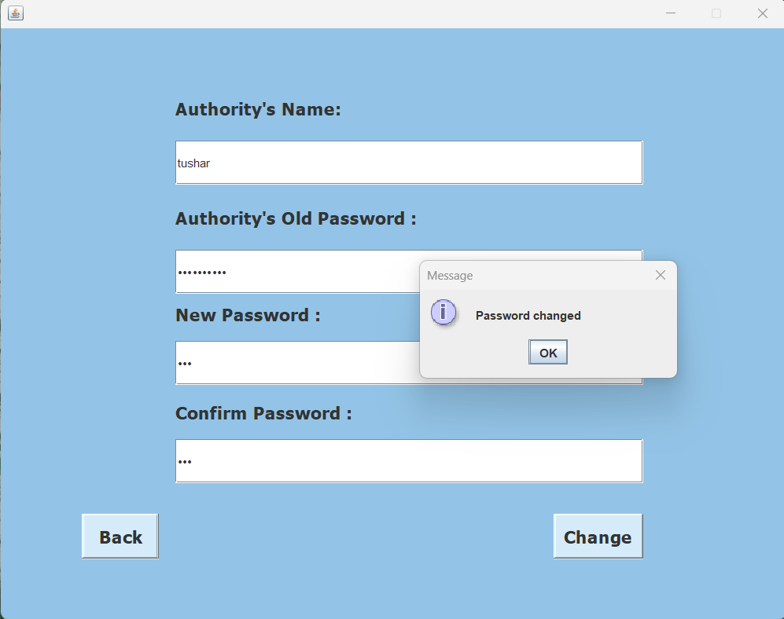
Implementation
Added players’ information with editing opportunities presented in left.
Changing password interface for authority will be confirmed by checking old password.

Slide 14
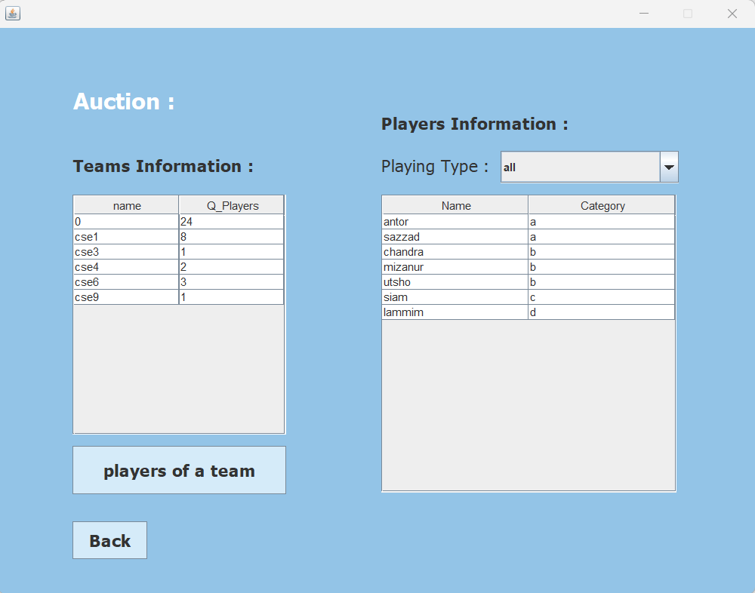
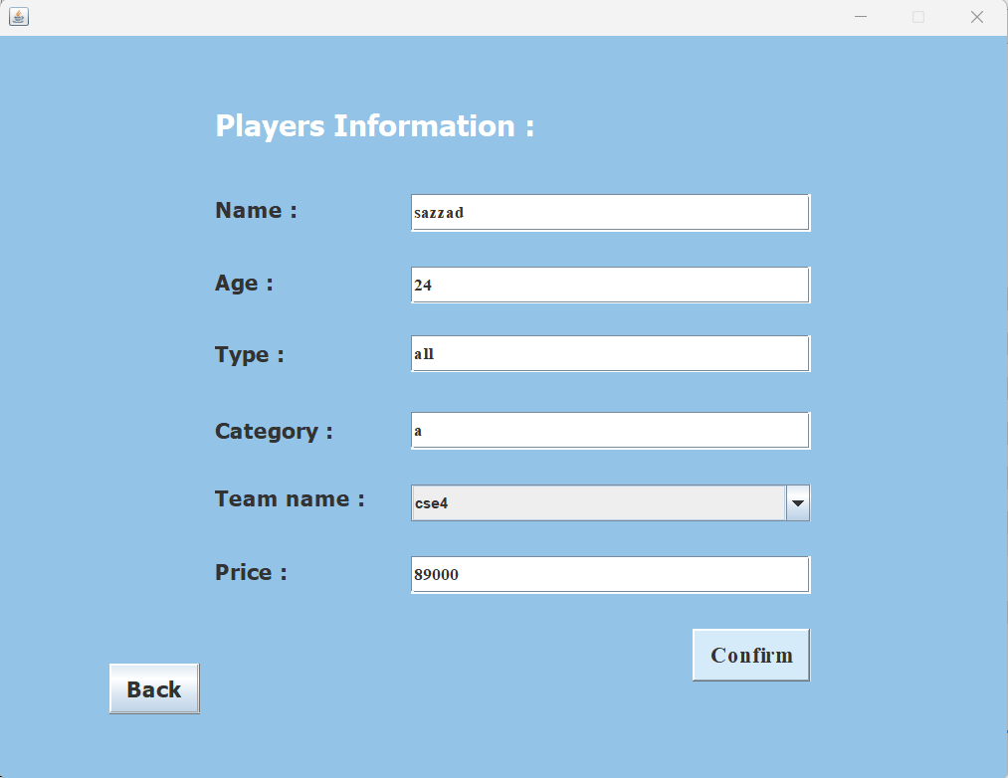
Implementation
In “Auction” process players information table will show players name and their category after selecting corresponding playing type. Team information table shows how many players are sold for a team.
After selecting a player by mouse clicked in players information table it will give new interface presented in right for selling a player.

Slide 15
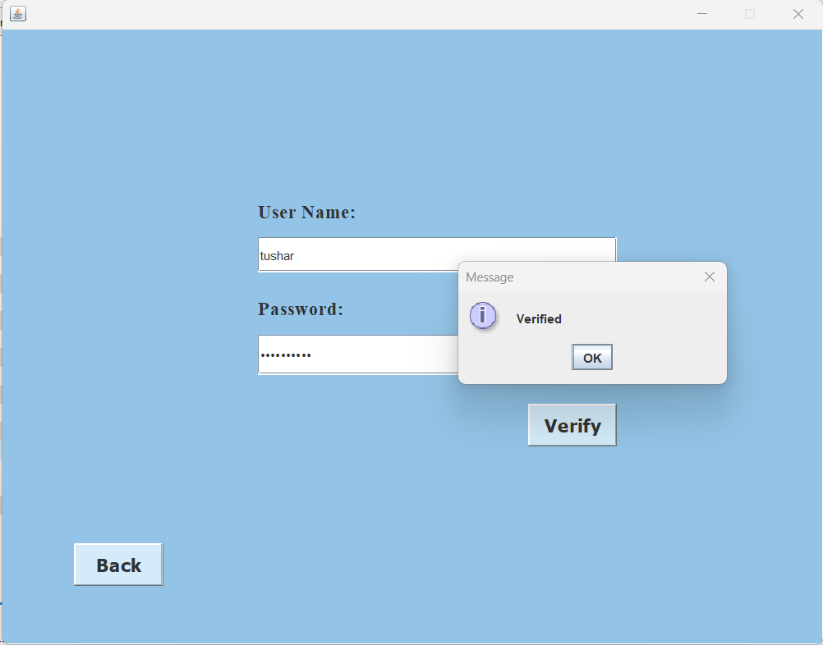
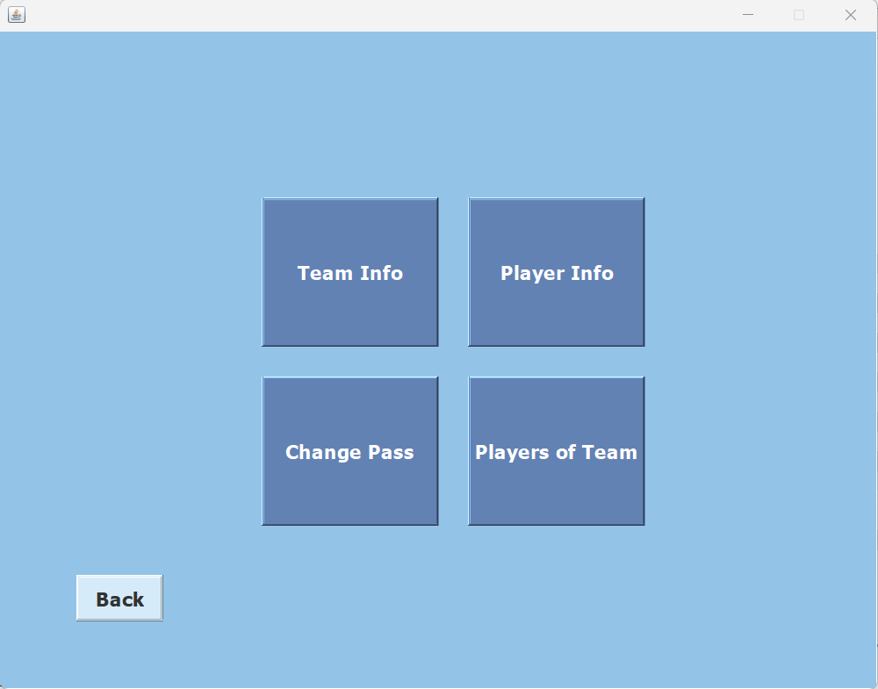
Implementation
Login system for users checks authentic access is presented in left.
User interface is presented in right which has four options mentioned as team info, password change for user and players bought by a team .

Slide 16
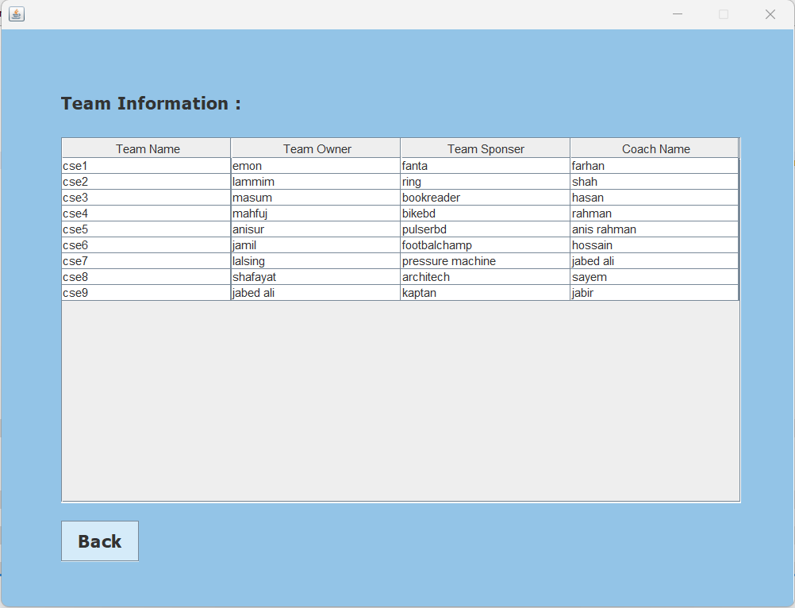
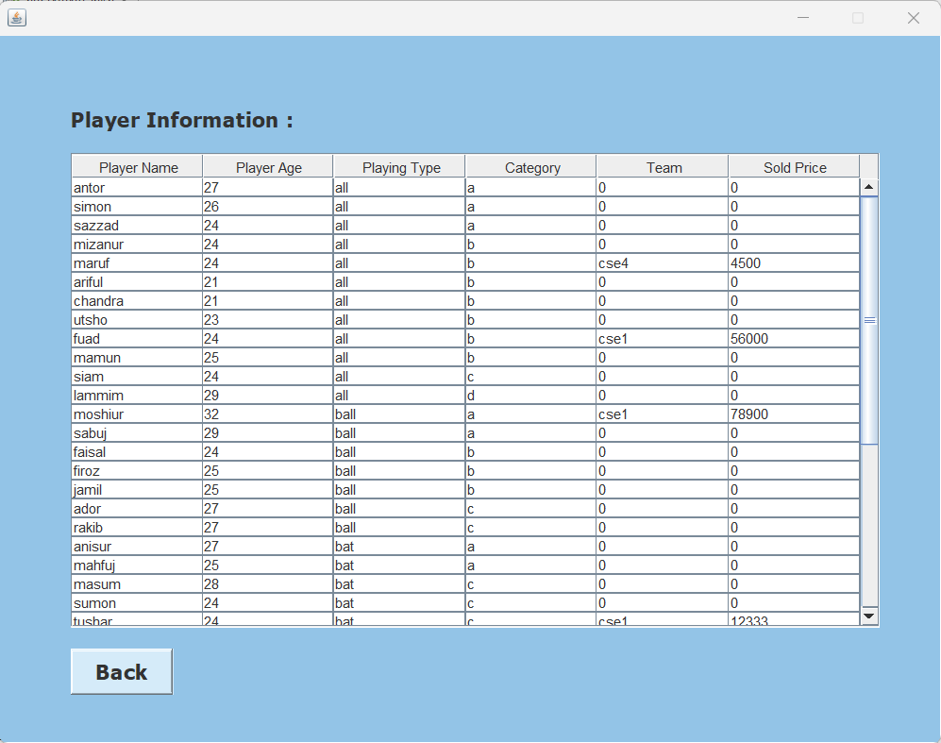
Implementation
Added teams’ information without editing opportunities presented in left.
Added players’ information without editing opportunities presented in right.

Slide 17
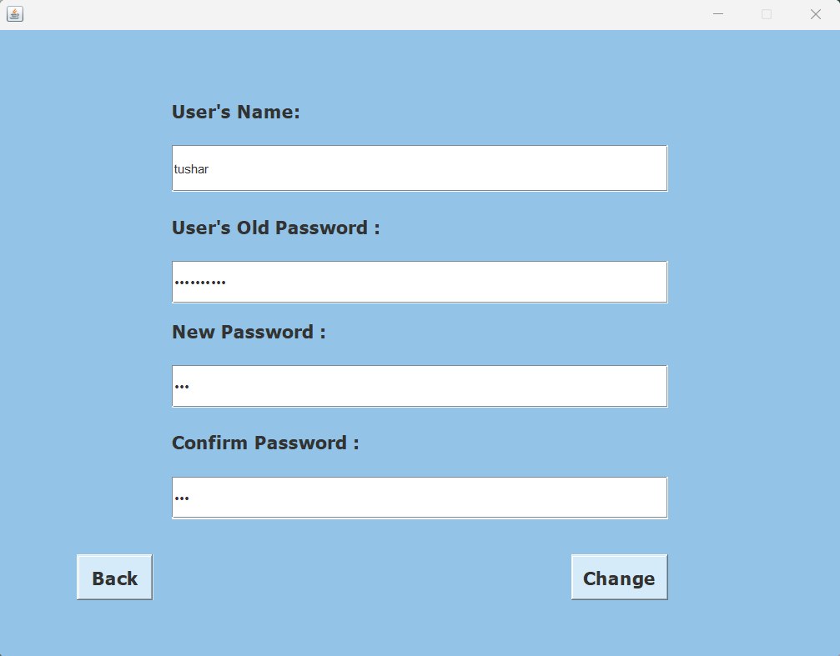
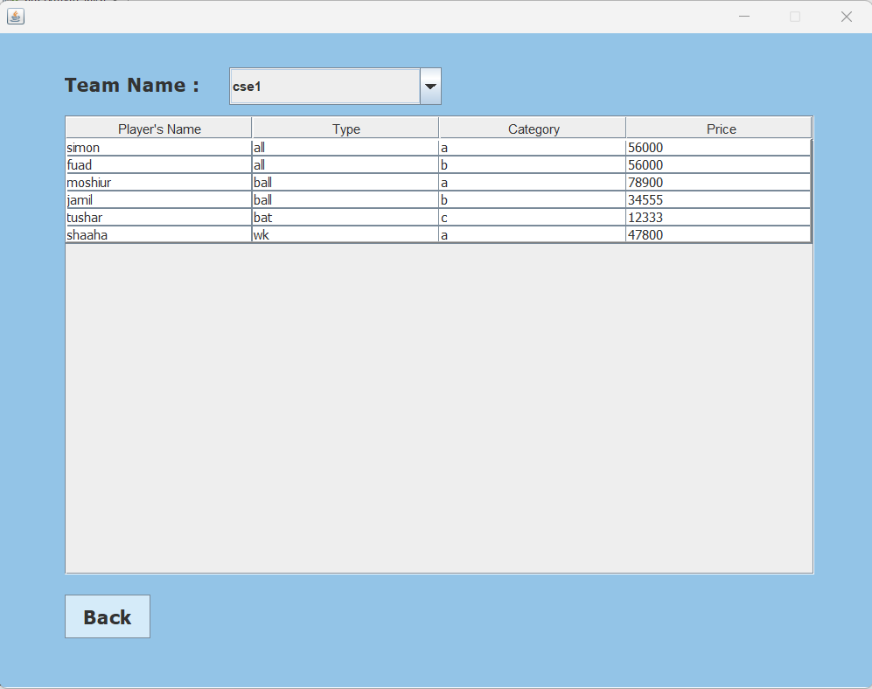
Implementation
Changing password interface for users will be confirmed by checking old password.
Players bought by a team will be presented after selecting a team name.

Slide 18
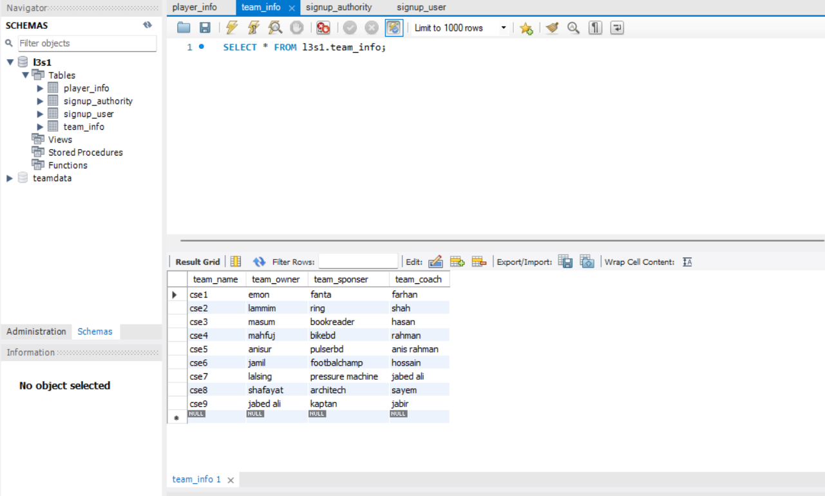
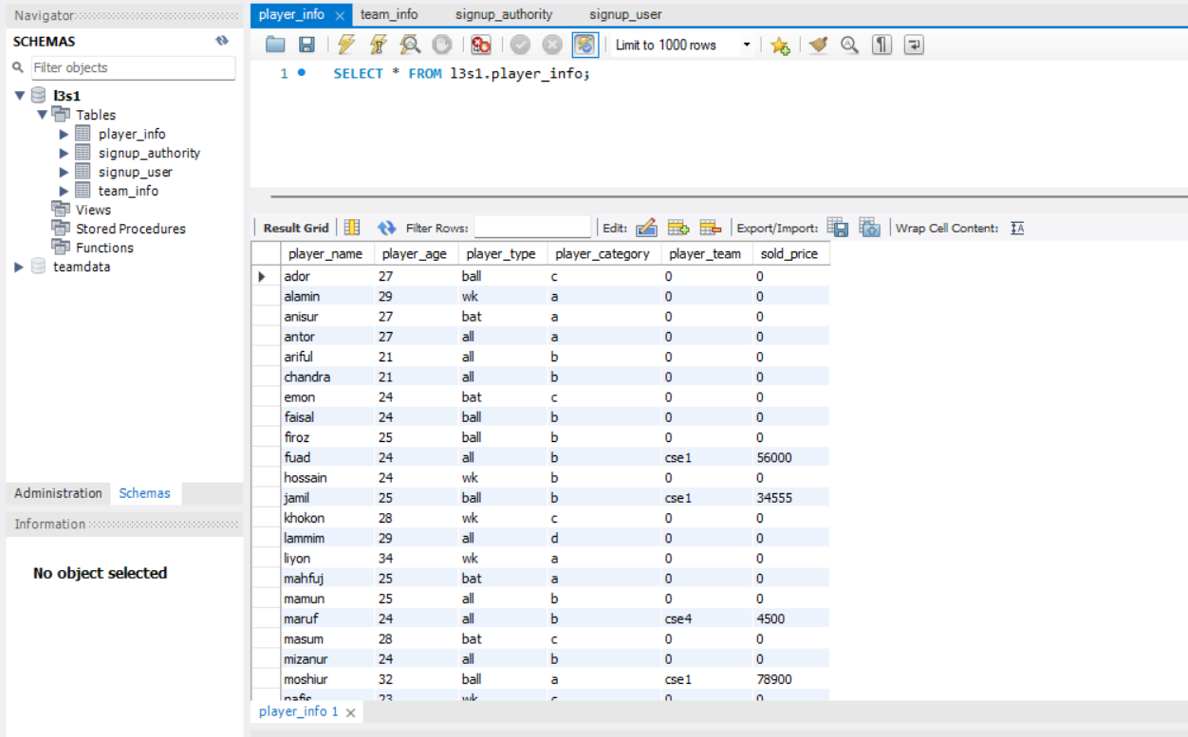
Implementation
Relational Table in database for storing players and authorities information with corresponding attributes visualized by My SQL Workbench is given below.

Slide 19
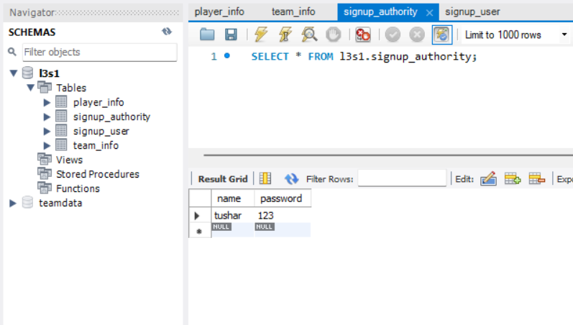
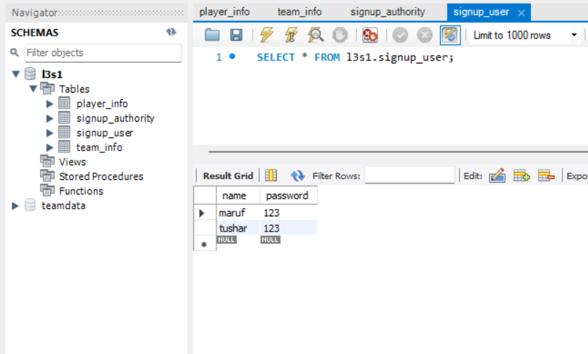
Implementation
Relational Table in database for storing login information visualized by My SQL Workbench is given below.

Slide 20
Future enhancement
In this, online payment for user can be implemented.
Live score update during live match and guest user can view score of live matches.
Tournament Owner side module can be implemented in Android Application.
Expansion of Android Application can be implemented
There is also possibility of Application for windows phone and IOS.

Slide 21
Conclusion
The main purpose of our project is to collect the information about player’s, teams and manages the auction process for a tournament.
In this project making our honorable mentor Dr. Ashish Kumar Mandal sir guided us. We have learnt many new methods ,techniques and applied them properly to complete our work.
However, we have plans to work more on this project and make it more functional and useful for the users.

Slide 22
reference
https://docs.oracle.com/javase/java/lang/Object.html
https://stackoverflow.com/questions/tagged/java
https://www.geeksforgeeks.org/java/
https://www.w3schools.com/java/java_methods.asp
https://github.com/mohammedabdulbari
https://www.javatpoint.com/method-in-java

Slide 23
Thank you & any question !!

